Slide 1

PSMAGE:
Balanced Map Generation for StarCraft
Alberto Uriarte and Santiago Ontañón
Drexel University
Philadelphia
August 11, 2013

Slide 2
Outline
Motivation
Introduction
Problem Definition
PSMAGE: Procedural Map Generation
Map Balance Analysis
Evaluation
Conclusions and Future Work

Slide 3
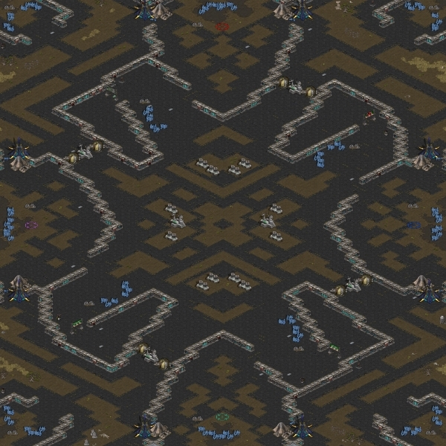
Motivation
Creating balanced maps for tournaments:
Time consuming
Difficult to do with conventional tools
A procedural map generation tool
Can save a designer a significant amount of time
Guarantee a fair playing field for the players

Slide 4
Outline
Motivation
Introduction
Problem Definition
PSMAGE: Procedural Map Generation
Map Balance Analysis
Evaluation
Conclusions and Future Work

Slide 5
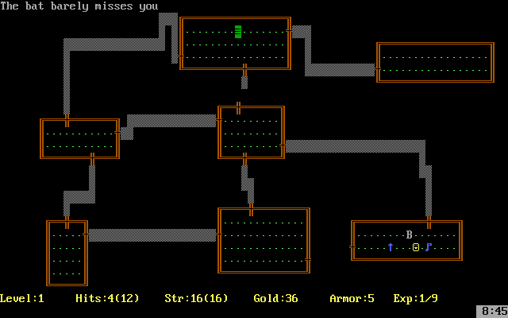
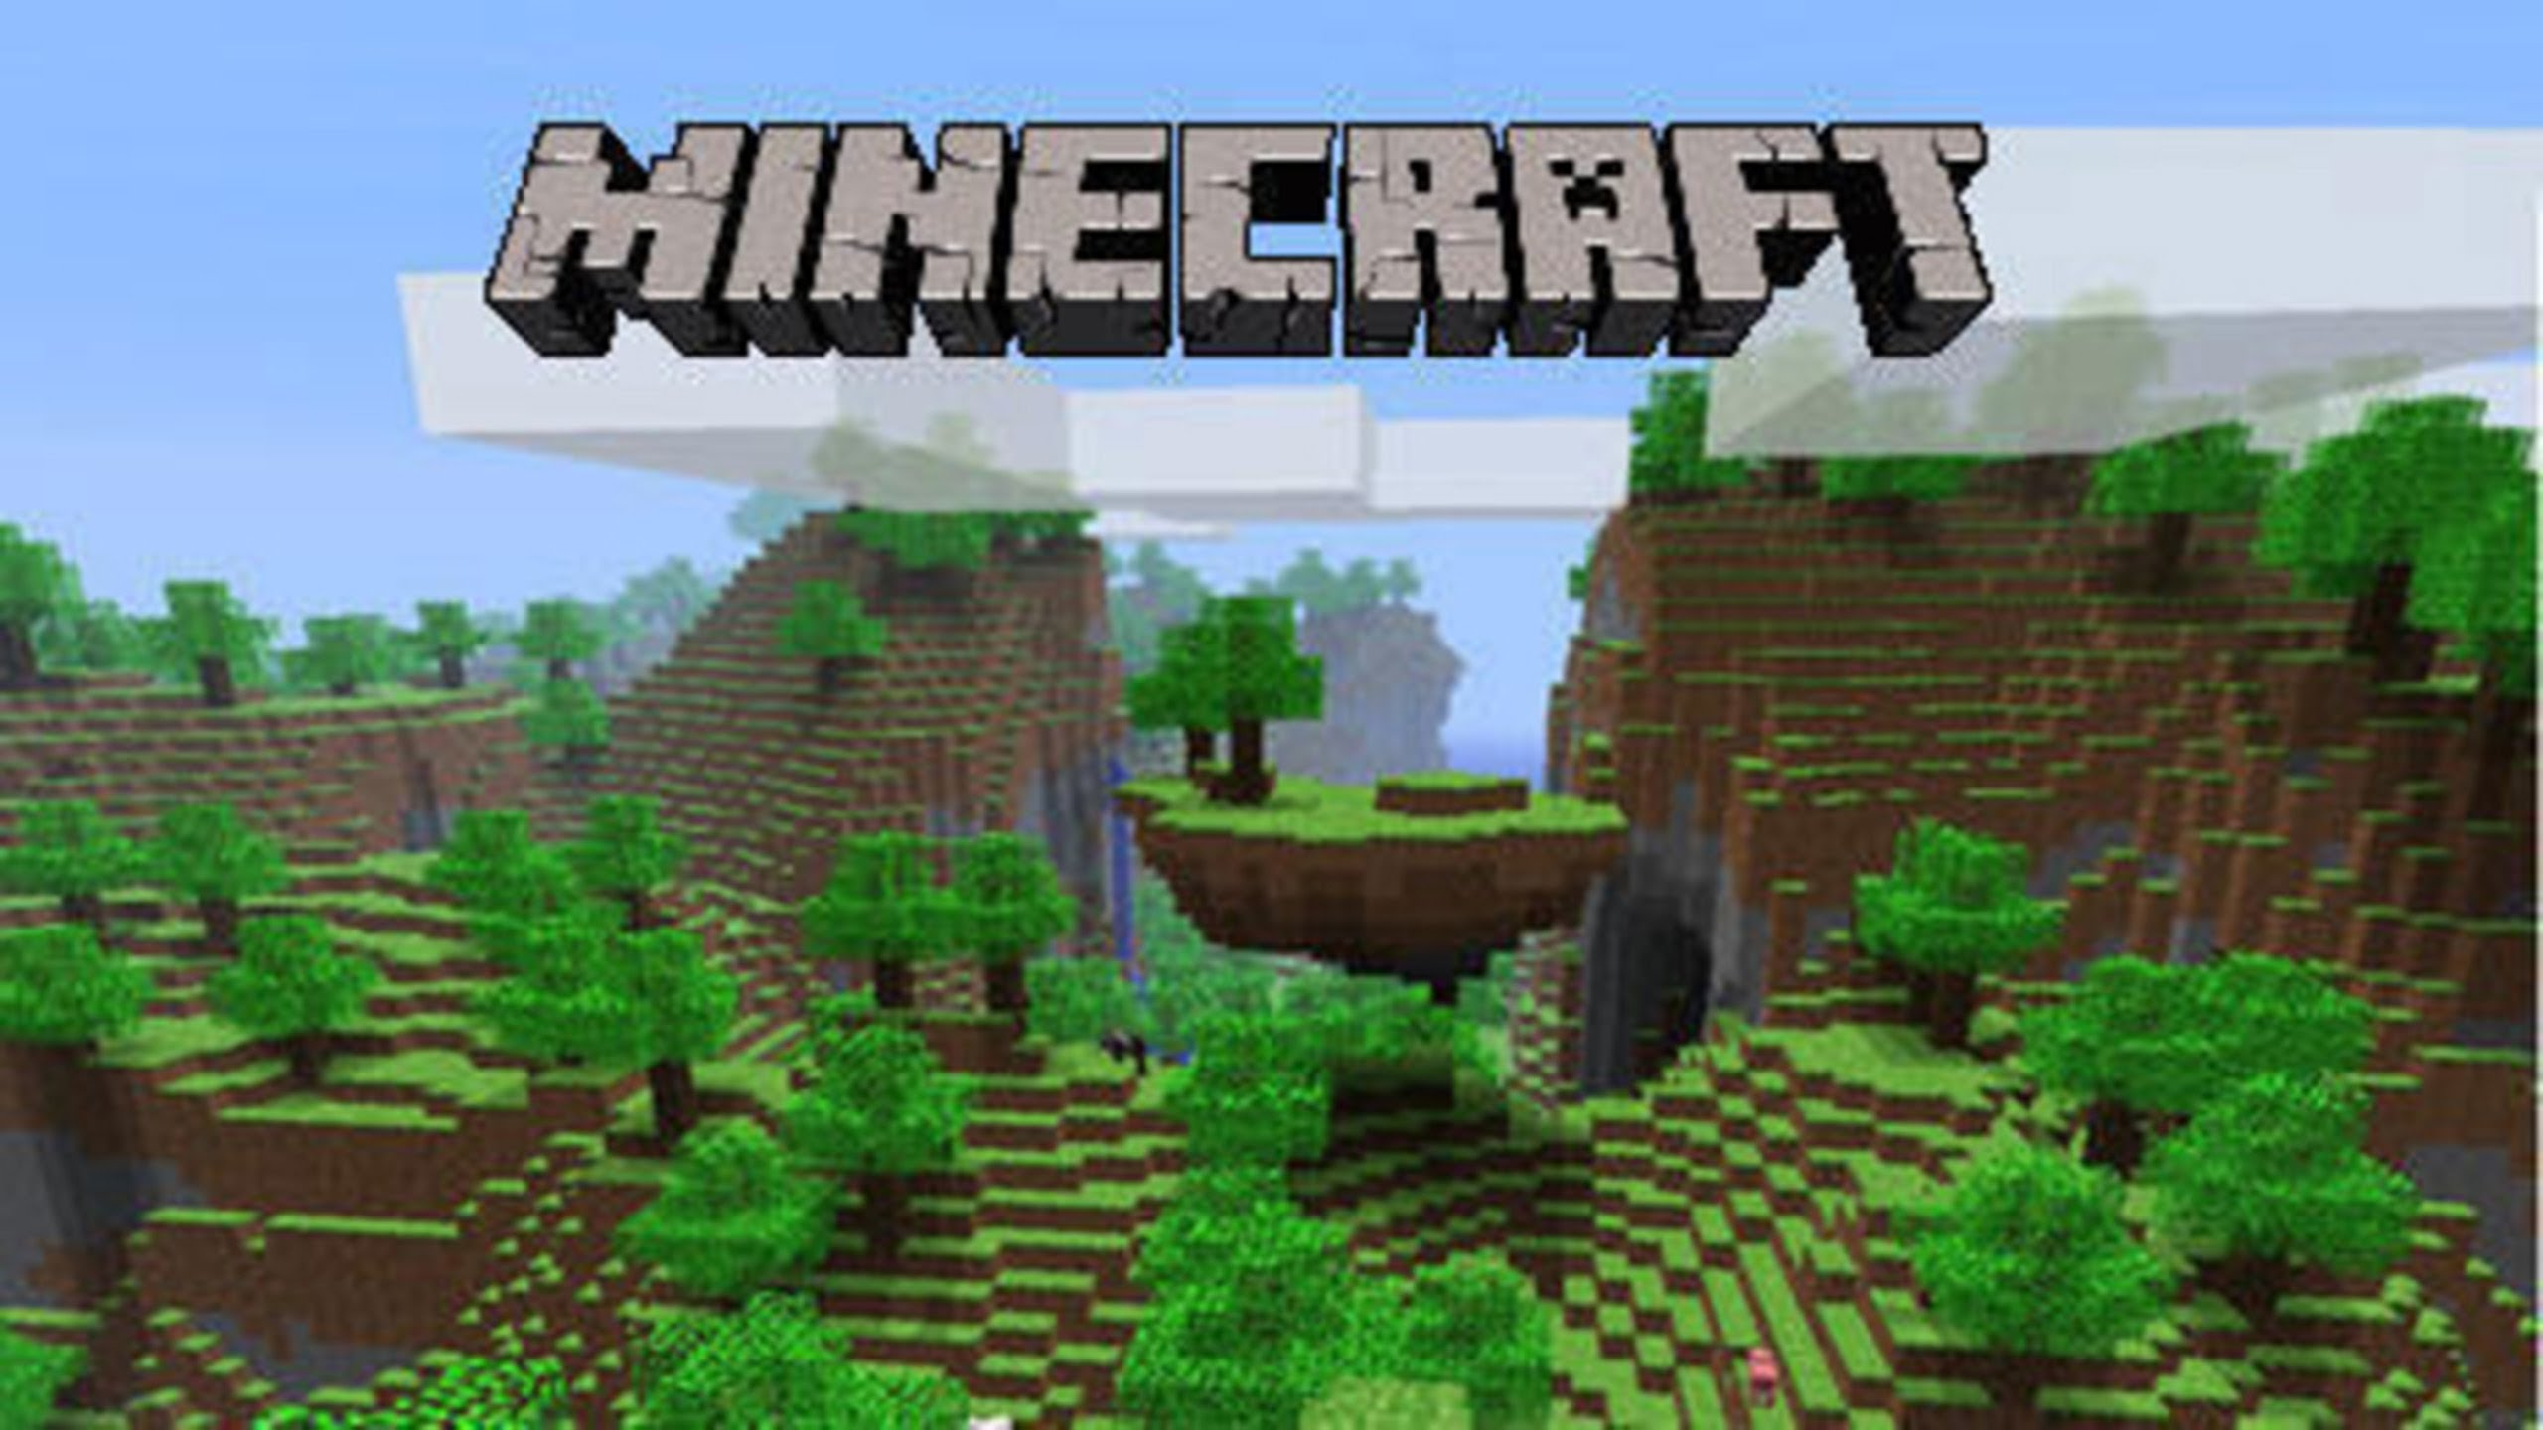
Introduction
Procedural map generation has a long way
From dungeons
To open worlds

Slide 6
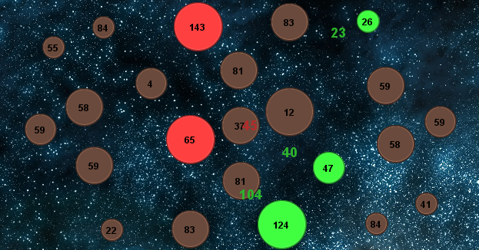
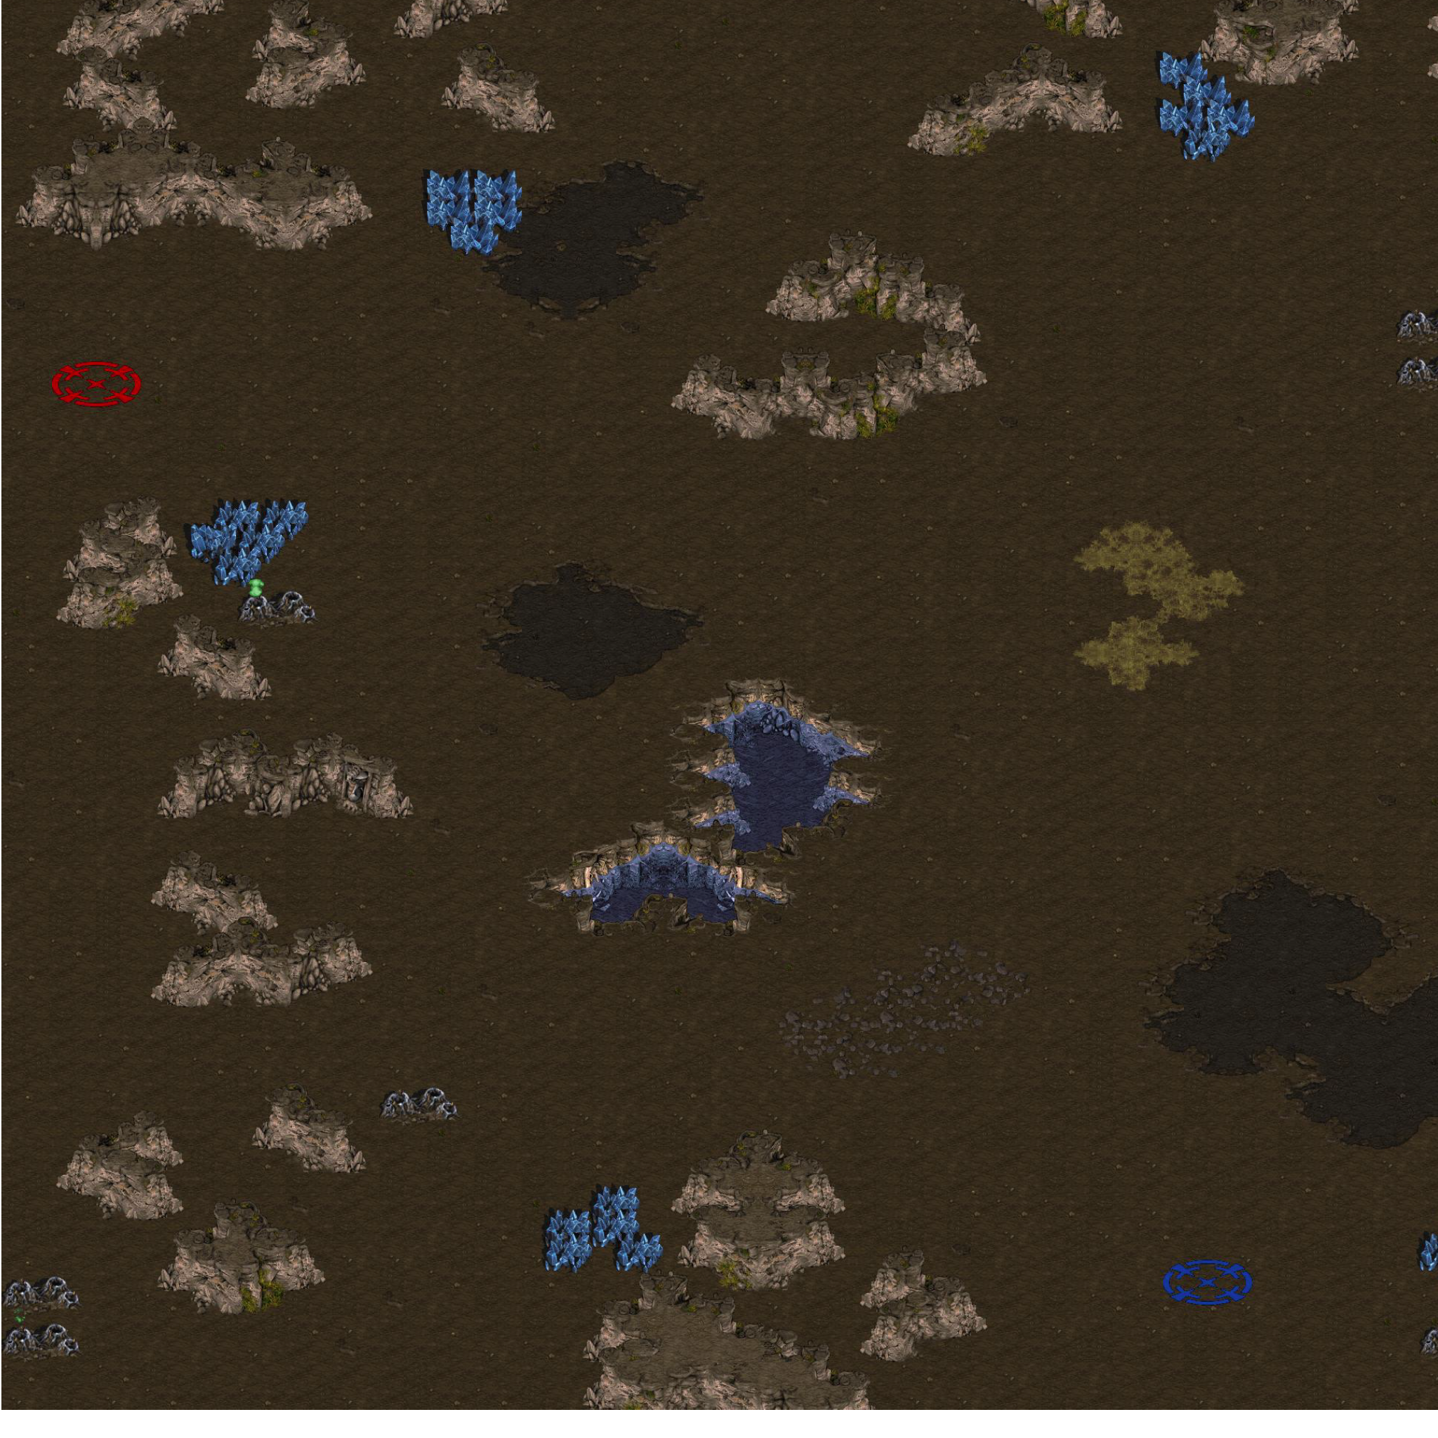
Introduction
Some previous work in RTS games
Planet Wars (Lara Cabrera et al.)
StarCraft (Togelius et al.)

Slide 7
Introduction
What is a Real-Time Strategy Game?
picture from Ben Weber
Notes:
Explain: resources and different races

Slide 8
Outline
Motivation
Introduction
Problem Definition
PSMAGE: Procedural Map Generation
Map Balance Analysis
Evaluation
Conclusions and Future Work

Slide 9
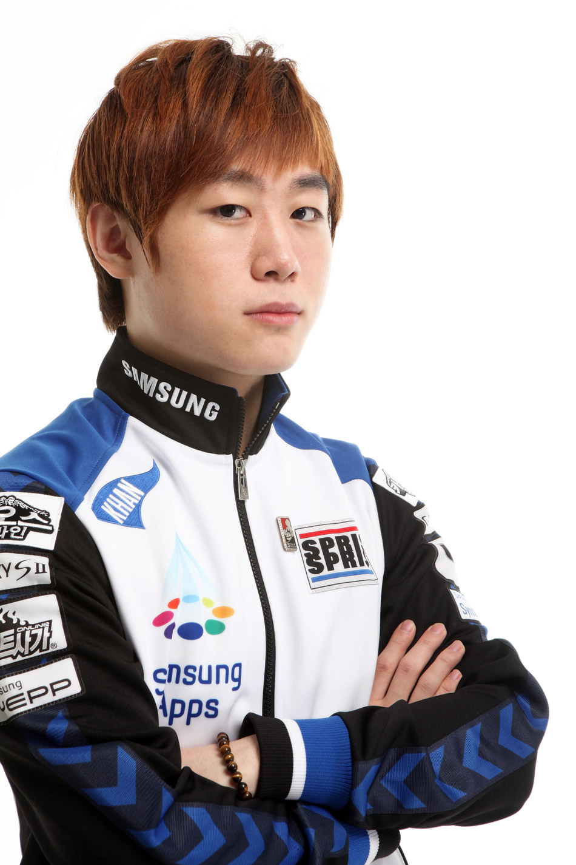
Problem definition
Generate Balanced Maps for StarCraft
Balanced map
If all the players have the same skill level, they all have the same chances of winning the game.
In the case of StarCraft, no race has a significant advantage over any other race.

Slide 10
Problem definition
Strategically interesting
There is a significant number of strategies with which a player can win the game.
There is no dominant strategy.
We are assuming that the races are already perfectly balanced. Then balanced maps are those in which all players have equal access to strategic locations:
regions and choke points.
Notes:
For example, maps that are too small might not be strategically interesting, since they only allow for early-game strategies.

Slide 11
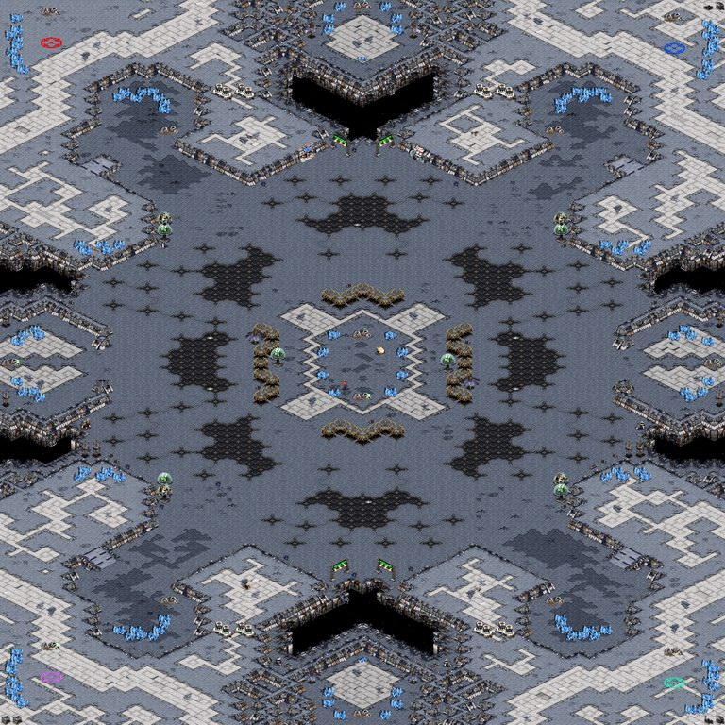
Strategic locations
Regions
List of choke points
Resources
Openness
Area
Choke Points
Width
Ramp
Starting points
Notes:
Openness: maximum value of the distance transform

Slide 12
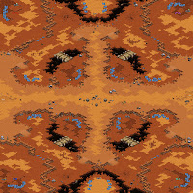
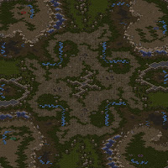
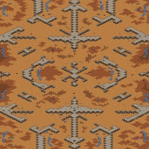
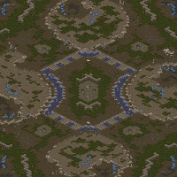
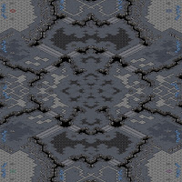
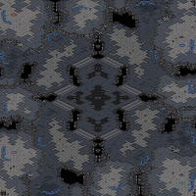
Tournament maps

Slide 13
Outline
Motivation
Introduction
Problem Definition
PSMAGE: Procedural Map Generation
Map Balance Analysis
Evaluation
Conclusions and Future Work

Slide 14
PSMAGE
Region generation: which generates the base layout of the map.
Determine elevation: determines the elevations of all the regions.
Starting position placement: assigns some regions as the starting positions for players.
Addition of base locations: adds resources to some of the regions of the map, making them potential regions for additional bases for players.
Map symmetry: through the use of symmetries, generate a final map likely to be balanced.
Realization: the map is translated into an actual StarCraft map.

Slide 15
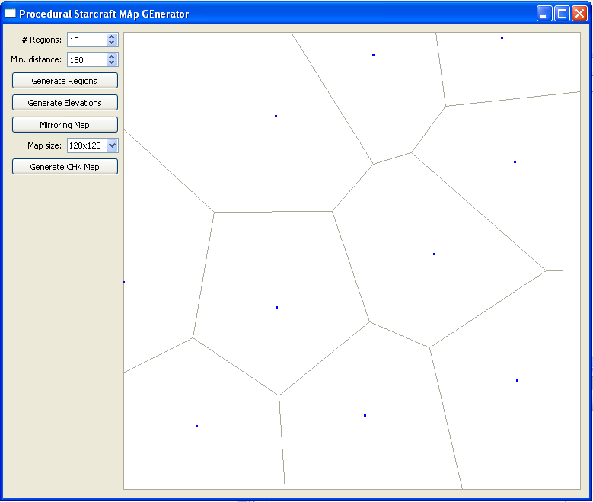
PSMAGE
Region generation: which generates the base layout of the map.
Poisson disk sampling to generate the seed points.
Fortune’s Algorithm to generate the Voronoi diagram.

Slide 16
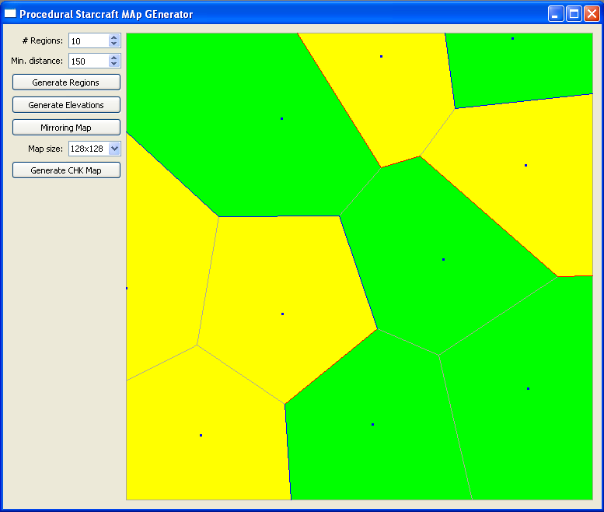
PSMAGE
Determine elevation: determines the elevations of all the regions.
We only consider 2 types of elevations: normal and high.
The region’s elevation is selected randomly given a parameter that defines the percentage of high regions.
Notes:
No ramps

Slide 17

PSMAGE
Starting position placement: assigns some regions as the starting positions for players.
We consider the k top-left-most regions in the map to be the starting point.
Constrains:
Openness of the starting region must be bigger than a threshold.
A path must exist between the starting location and a region on the right border and a region on the bottom border.

Slide 18
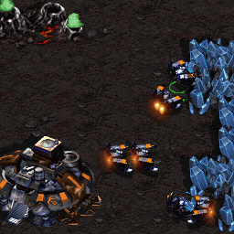
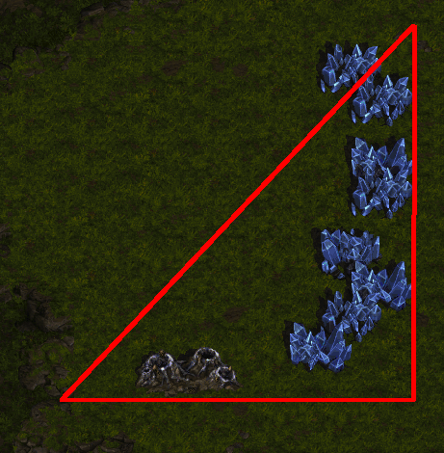
PSMAGE
Addition of base locations: adds resources to some of the regions of the map, making them potential regions for additional bases for players.
We have to ensure an equidistance distance from a base to all nearby resources
Notes:
L shape

Slide 19
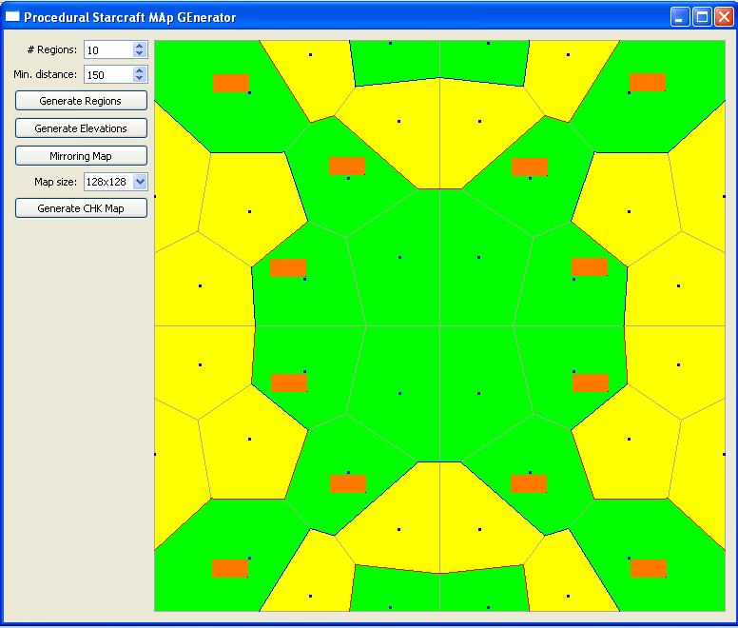
PSMAGE
Map symmetry: through the use of symmetries, generate a final map likely to be balanced.

Slide 20
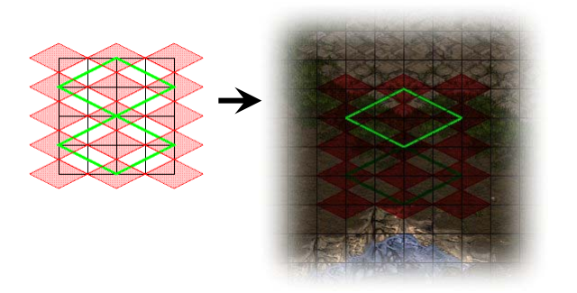
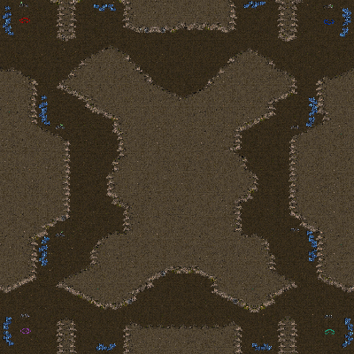
PSMAGE
Realization: the map is translated into an actual StarCraft map.

Slide 21
PSMAGE
Our map generation method can be categorized as:
Offline. Since it takes place during game design.
Necessary to play tournament games.
Combination of random seeds and a control vector.
Stochastic. Given the same features the output is unpredictable.
Constructive approach. Although in step 4 we follow a generate and test schema with a fitness function.

Slide 22
Outline
Motivation
Introduction
Problem Definition
PSMAGE: Procedural Map Generation
Map Balance Analysis
Evaluation
Conclusions and Future Work

Slide 23
Map balance analysis
Metrics defined for balance maps
Starting location area
Starting location openess
Starting location ground distance
Starting location air distance
2 Expansions distance
All expansions distance
Choke point symmetry distance
Choke point symmetry width

Slide 24
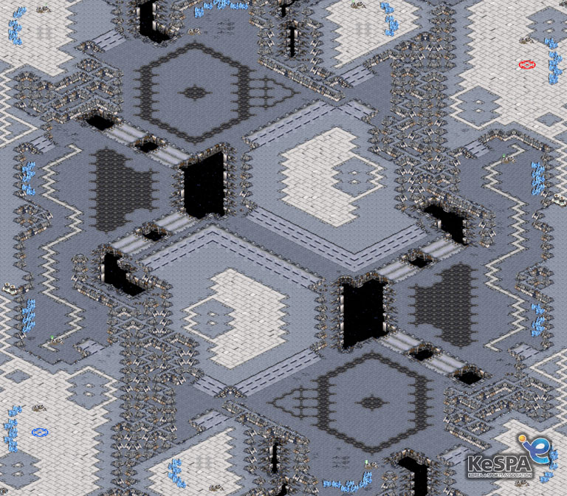
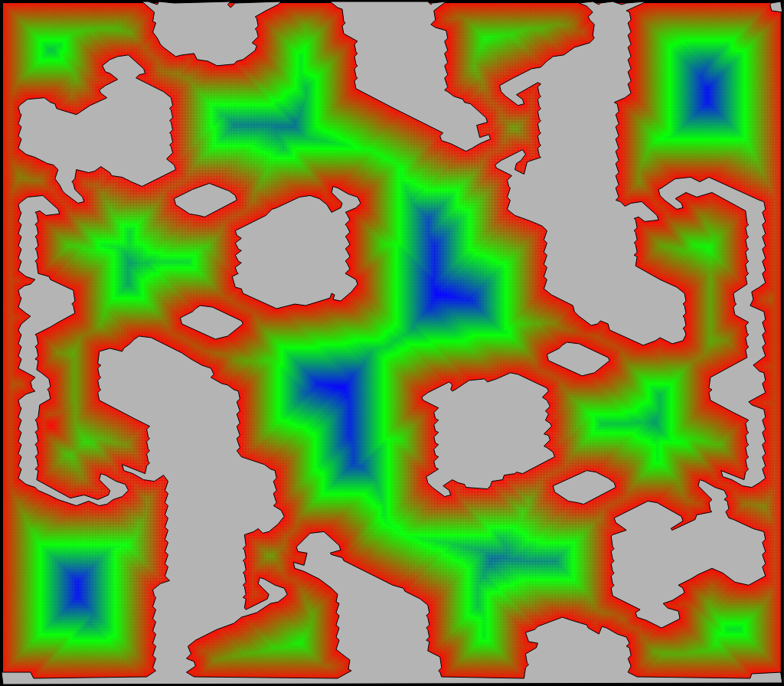
Map balance analysis
Starting Location Space
Area.
Openess. The maximum value of the distance transform.

Slide 25
Map balance analysis
Starting Location Spread
Ground distance.
Air distance.

Slide 26
Map balance analysis
Base Expansion Accessibility
Ground distance to first and second expansion
Notes:
You can only make two expansion before a inevitable military conflict

Slide 27
Map balance analysis
Base Location Distribution
Minimize the standard deviation of the standard deviation of the ground distance from one starting point to all the base locations.

Slide 28
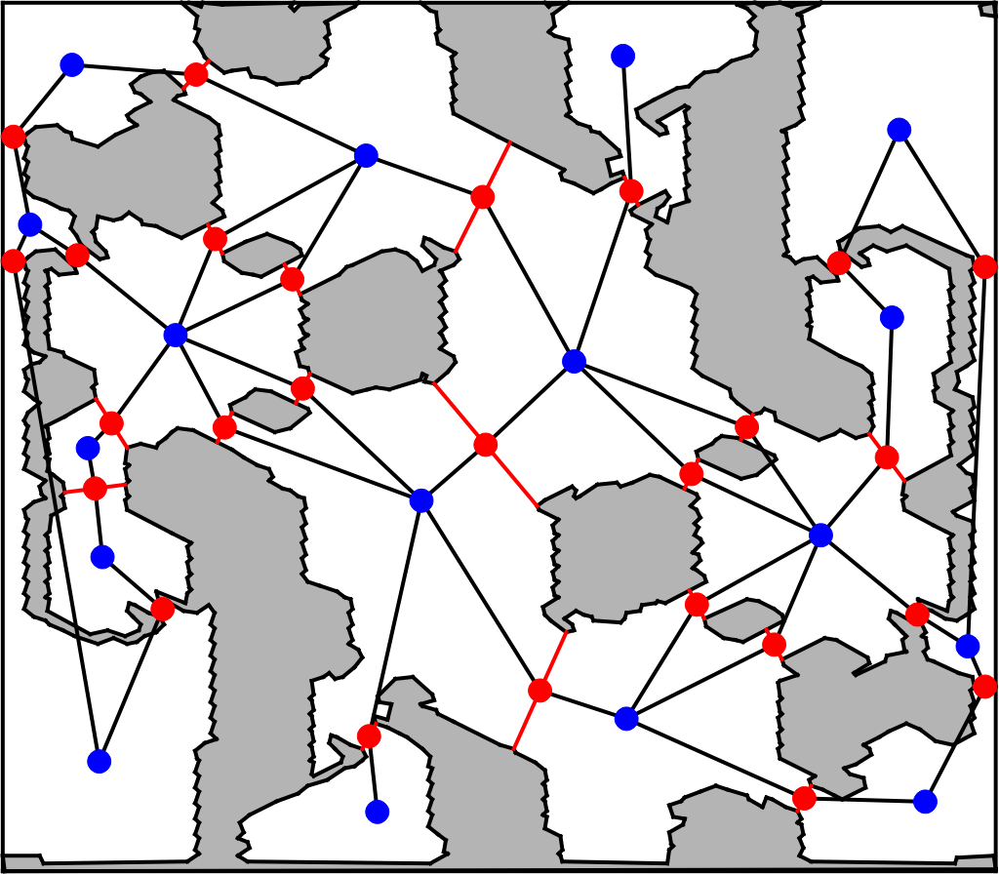
Map balance analysis
Choke Points Symmetry
For each pair of symmetric choke points compute:
Ground distance to base.
Width.

Slide 29
Map balance analysis
Choke Points Symmetry
For each pair of symmetric choke points compute:
Ground distance to base.
Width.
BWTA has false negatives

Slide 30
Outline
Motivation
Introduction
Problem Definition
PSMAGE: Procedural Map Generation
Map Balance Analysis
Evaluation
Conclusions and Future Work

Slide 31
Evaluation
We analyzed 11 StarCraft tournament maps
 | Average | Standard deviation | PSMAGE
Starting location area | 49,978.08 | 37,890.48 | 60,5589.70
Starting location openess | 2.47 | 1.44 | 0.00
Starting location ground distance | 523.90 | 142.55 | 1,313.33
Starting location air distance | 771.25 | 204.62 | 695.10
2 Expansions distance | 271.57 | 182.25 | 130.99
All expansions distance | 74.95 | 77.40 | 8.95
Choke point symmetry distance | 199.83 | 99.44 | 283.49
Choke point symmetry width | 46.08 | 41.50 | 30.49
Notes:
11 maps win balance between races
No relationship between balance maps and metrics
Inaccuracies BWTA
NightFall no tornament map, worst scores

Slide 32
Outline
Motivation
Introduction
Problem Definition
PSMAGE: Procedural Map Generation
Map Balance Analysis
Evaluation
Conclusions and Future Work

Slide 33
Conclusions and Future Work
Conclusions
Future work
Using the metric proposed we showed that the maps generated are comparable with the professional ones.
Improve BWTA to produce less false negative.
Add a decoration step for a better looking map.
Use generative-and-test approach with the map balance features instead of symmetries.
Add metrics to analyze the strategically interest of the map.

Slide 34

PSMAGE:
Balanced Map Generation for StarCraft
Alberto Uriarte albertouri@cs.drexel.edu
Santiago Ontañón santi@cs.drexel.edu

